Slide 1
Russian stock market visualization
Salavat Faizullin, Ruslan Gatiatullin, Ilya Grigorev

Slide 2
What our project is about
Visualizing historical returns of the Russian stock market
Providing useful insights for potential investors
Providing interesting facts for ordinary users

Slide 3
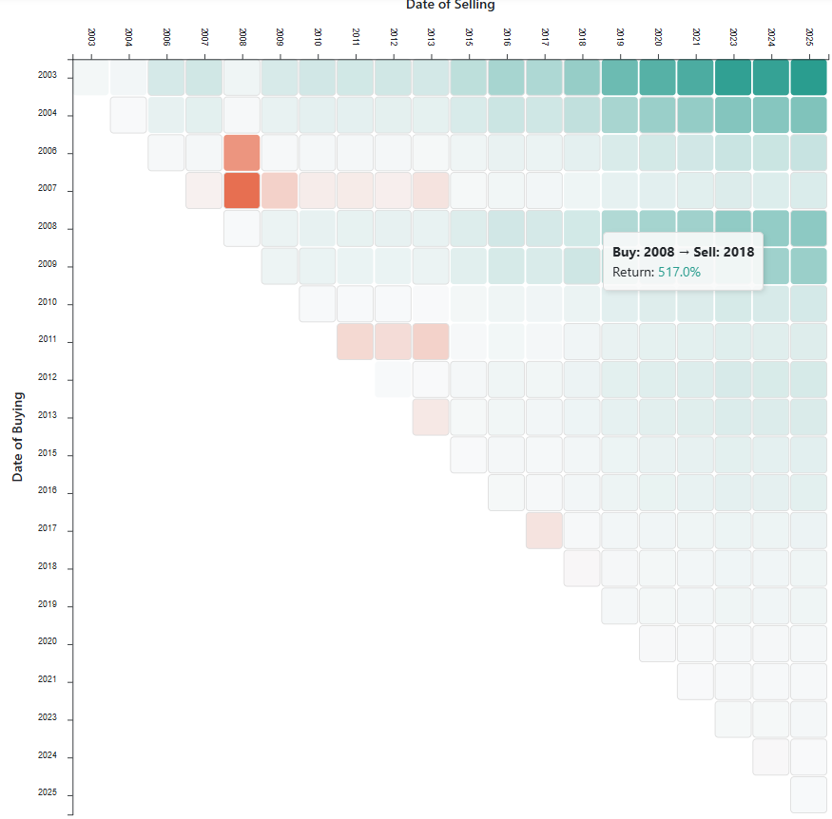
Our result
We have implemented three visualizations
The main one is the market returns heatmap
For example, if you invested ₽1000 in 2008, you would’ve had ₽6170 in 2018
Can choose between annual and total return

Slide 4
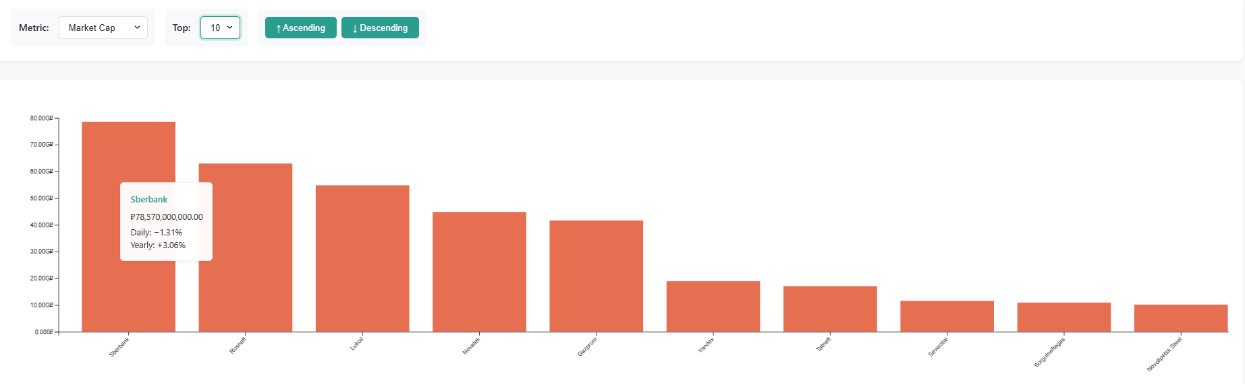
Our result
Our second visualization is an interactive bar chart

Slide 5
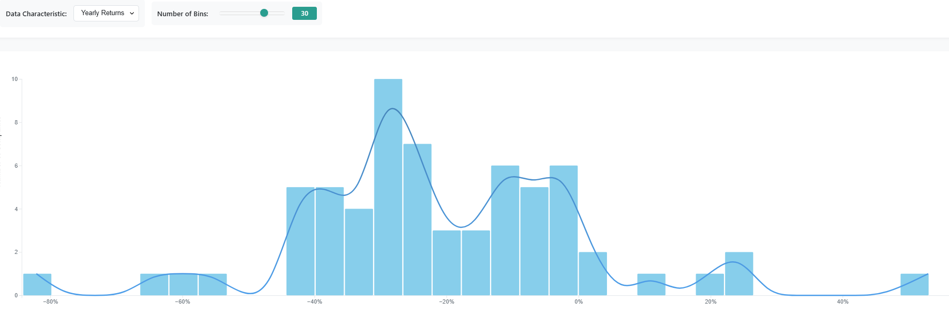
Our result
Our third visualization is the distribution of stock price increase of the largest Russian companies year-to-year

Slide 6
How our project can be useful
Investors can choose desired proportion of stocks in their portfolio based on their risk-tolerance
Investors can compare how good different Exchange Tradable Funds (ETF’s) are at tracking the broad stock index

Slide 7
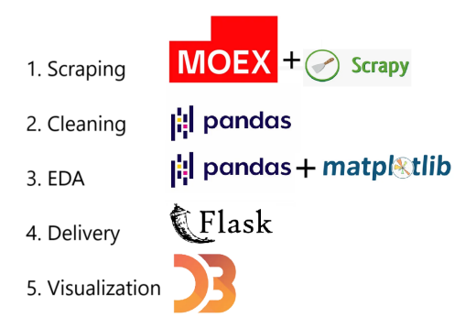
Development process

Slide 8
Challenges
Two team members are studying on exchange in two different countries
Our timezones are quite different
Moscow Exchange website (main source of our data) can be hard to work with:
Might not load from outside Russia for multiple days in a row, even with a VPN
Interactions required for scraping are generally poorly made and need workaround
For example, specifying FROM and TILL parameters in URL does nothing in reality
Many other things like that

Slide 9
Thank you!
Full visualization:
http://5.129.199.157:8080/
GitHub repo:
https://github.com/Data-Wrangling-and-Visualisation/Stock-Market-Visualization

